Slide 1
The Many Lives of Research Data: A Discussion on Organizing, Preserving & Sharing
Gina Bastone and Melanie Radik
Based on material created for the New England Collaborative Data Management Curriculum by:
Andrew Creamer, UMass Medical School
Donna Kafel, UMass Medical School
Elaine Martin, UMass Medical School
Regina Raboin, Tufts University
Generously funded by NLM grant HHS-N-276-2011-00010-C
Notes:
This presentation is meant to give an overview of the state of research data production; common use, and re-use best practices; and growing trends in research. Much more can be said on all of these topics, and this overview itself was designed by New England librarians as the start of a 7-module curriculum on data management: the New England Collaborative Data Management Curriculum (NECDMC)
It is our hope that this presentation leaves you more thoughtful about managing your data, and expands your understanding of LTS services as an ally and resource in the university’s research enterprise.

Slide 2
Why Manage Data?
“And yet, data is the currency of science, even if publications are still the currency of tenure. To be able to exchange data, communicate it, mine it, reuse it, and review it is essential to scientific productivity, collaboration, and to discovery itself”
(Gold 2007).
Notes:
Anna Gold. Cyberinfrastructure, Data, and Libraries, Part 1: A Cyberinfrastructure Primer for Librarians. D-Lib Magazine, September/October, 2007, Volume 13 Number 9/10 http://www.dlib.org/dlib/september07/gold/09gold-pt1.html.
“Managing and sharing data…
increases the impact and visibility of research;
promotes innovation and potential new data uses;
leads to new collaborations between data users and creators;
maximizes transparency and accountability;
enables scrutiny of research findings;
encourages improvement and validation of research methods;
reduces cost of duplicating data collection;
and provides important resources for education and training”
Increase the visibility of your research:
- Save time
- Simplify your life
- Preserve your data
- Increase your research efficiency
- Documentation for ownership
- Meet grant requirements
- Facilitate new discoveries
- Support Open Access

Slide 3
Types of Research Data
Observational
Qualitative
Experimental
Simulation data
Derived or compiled data
Notes:
Research at Brandeis generates many different types of data, all come with documentation. This list is by no means comprehensive but still illustrates some of the variety, from qualitative data such as subject interviews to what could be purely numerical experimental results from physics. The tools used to generate data are equally important. Knowing what equipment software an instrument used or the exact code used to run an analysis is critical to reproducibility.
University of Virginia “What is Research Data?”
Module 2 of the NECDMC curriculum covers much more about the various types and formats for research data. More examples of types of data include:
Documents (text, Word), spreadsheets
Laboratory notebooks, field notebooks, diaries
Questionnaires, transcripts, codebooks
Survey responses
Health indicators such as blood cell counts, vital signs
Audio and video recordings
Images, films
Protein or genetic sequences
Spectra
Test responses
Slides, artifacts, specimens, samples
Database contents (video, audio, text, images)
Models, algorithms, scripts
Software code, software for simulation
Methodologies and workflows
(credit: http://library.uoregon.edu/datamanagement/datadefined.html).

Slide 4
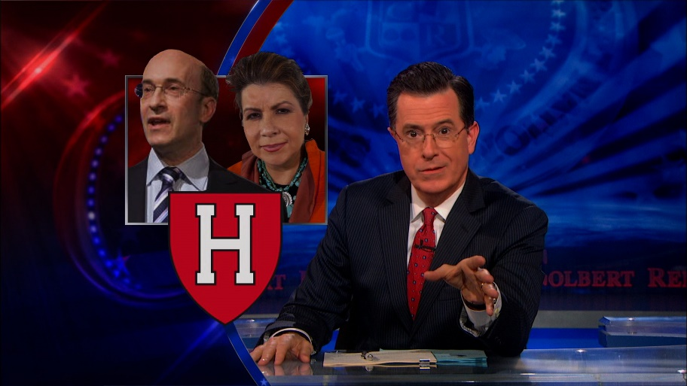
3 Good Reasons for Managing Your Data
Personal research advantages
Avoid duplication of efforts
Find older data quickly
Increase citation impact and discoverability
of your research
Avoid errors that get you mocked by Colbert
Transparency & integrity
Defend publication challenges
Patent & copyright security
Compliance
IRB
Funding agencies’ requirements
Publishers’ requirements
Notes:
Personal research advantages:
Managing data saves you time and effort, and avoids the duplication of efforts, particularly when your research team changes regularly with grads, undergrads, and post-docs coming and going regularly. You can easily find the data you need and make these available should you be asked. This year the NSF wanted researchers to account for all scholarly products, including data, resulting from their funding. In addition, publishing your data can increase your citation impact and discoverability of your research & help with P &T.
Transparency & integrity:
Who is familiar with Thomas Herndon, the UMass Amherst grad student who published a critique of the economists Reinhart and Rogoff? An example of why data should be preserved and shared - if what we do is important (and at times, saves lives, improves lives, influences policy) then we should be as transparent as possible with our process, which includes sharing data.
Compliance:
Managing data is a part of compliance with the University’s IRB, your funders’ data sharing and data management policies. Funders like the NIH reserve the right to audit your lab notebooks and pre-publication data; Since 2011 the NSF has required a data management plan and the federal govt. is currently working to make publicly funded research data available to the public. Several journals, such as PLoS, have begun requiring deposition of data in a repository before publishing your article.

Slide 5
Emerging Federal Requirements
“The Administration is committed to ensuring that…the direct results of federally funded scientific research are made available to and useful for the public, industry, and the scientific community. Such results include peer-reviewed publications and digital data” (Holdren 2013).
Notes:
The government has been increasingly interested in preserving and sharing the results of federally funded research, particularly in the medical and public health areas. NCBI launched PubMed for articles and traditional outputs of research in 2000, and the government has been increasing its efforts to host and share research data – which, as the new currency of data, makes sense.
Quote from: Expanding Public Access to the Results of Federally Funded Research, Office of Science and Technology Policy: http://www.whitehouse.gov/blog/2013/02/22/expanding-public-access-results-federally-funded-research

Slide 6
Notes:
The White House devotes website space to outlining the Executive Order to make government more accessible. Project Open Data established a GitHub account for posting and improving governmental data.
http://www.whitehouse.gov/blog/2013/05/16/introducing-project-open-data

Slide 7
Notes:
Federal funding agencies under the umbrella of the NIH are particularly active in data repository hosting, in large part due to the Human Genome Project.
There several types of repositories; some are open and some are closed. There are disciplinary and subject data repositories, multidisciplinary repositories, regional and local repositories, and institutional repositories.
On the slide is a sample of data repositories currently funded by the NIH. Notice that this year the NLM has made their policies and instructions for submitting data very clear to assist researchers with sharing and archiving their data: http://www.nlm.nih.gov/NIHbmic/nih_data_sharing_repositories.html

Slide 8
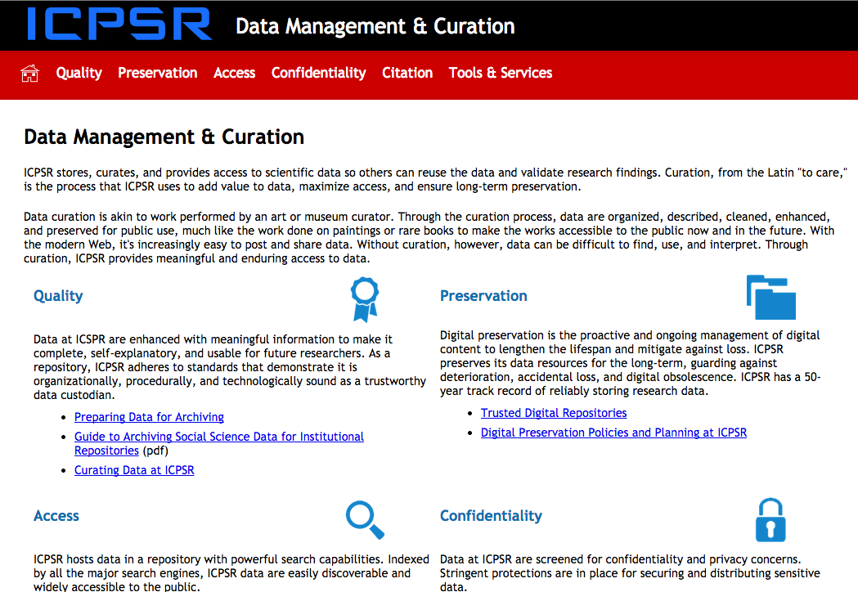
Notes:
The ICPSR for social studies data, the largest social science data repository, has clear guidelines for managing and organizing one’s data for inclusion in the database, to make it useable by others.
http://www.icpsr.umich.edu/icpsrweb/content/datamanagement/index.html

Slide 9
Notes:
Even publishers are interested in data, expanding the traditional supplemental data addendums from tables and figures that wouldn’t fit a page limit to complete datasets and the metadata to make them comprehensible. Publishers rarely maintain a data repository themselves, but generally recommend a subject-specific or reputable general-science repository like Dryad. PLoS journals have instructions for authors for data archiving, and the JDAP is an agreement among some of the major scientific publishers including the Nature Publishing Group, to ensure the integrity of the articles and research findings they publish by having their authors deposit their data in a repository such as DRYAD to make the underlying data available for scrutiny by the public and scientific community.
http://datadryad.org/pages/jdap

Slide 10
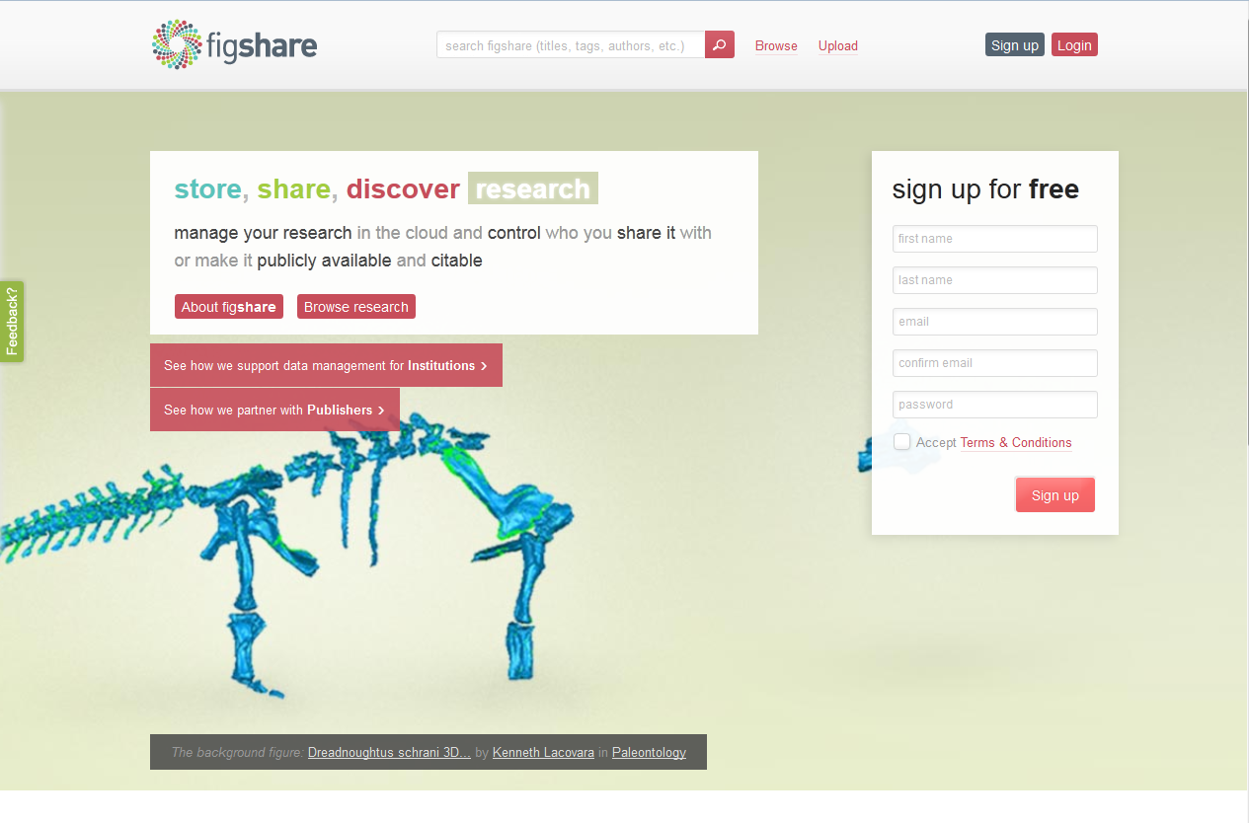
Notes:
Other data repositories that aren’t subject specific include figshare: http://figshare.com/

Slide 11
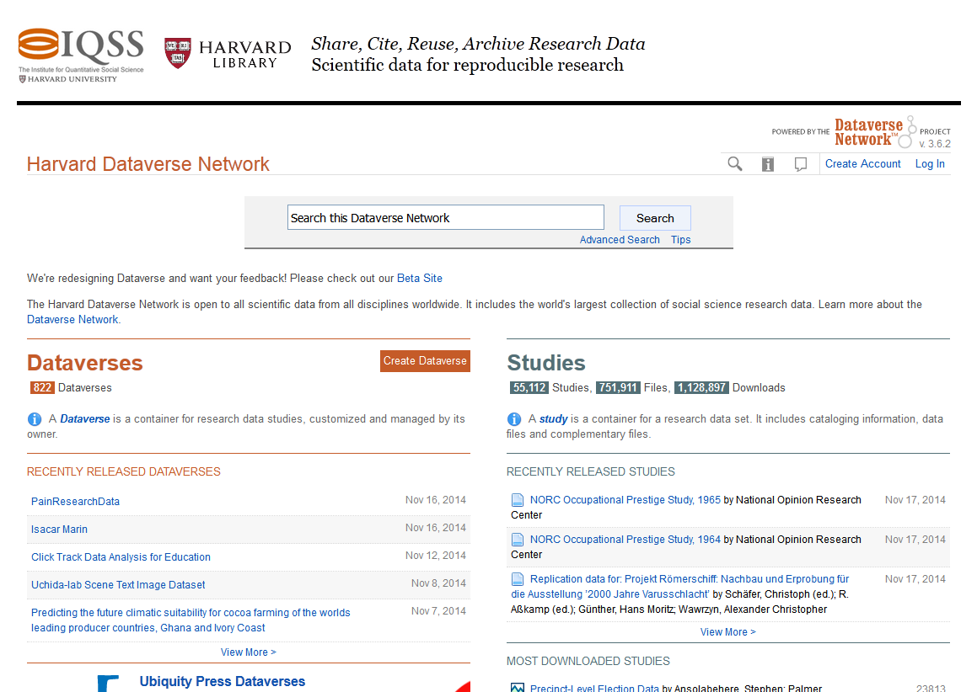
Notes:
and the Harvard Dataverse. These repositories even offer institutional level account management, in addition to the individual-researcher level.
https://thedata.harvard.edu/dvn/

Slide 12
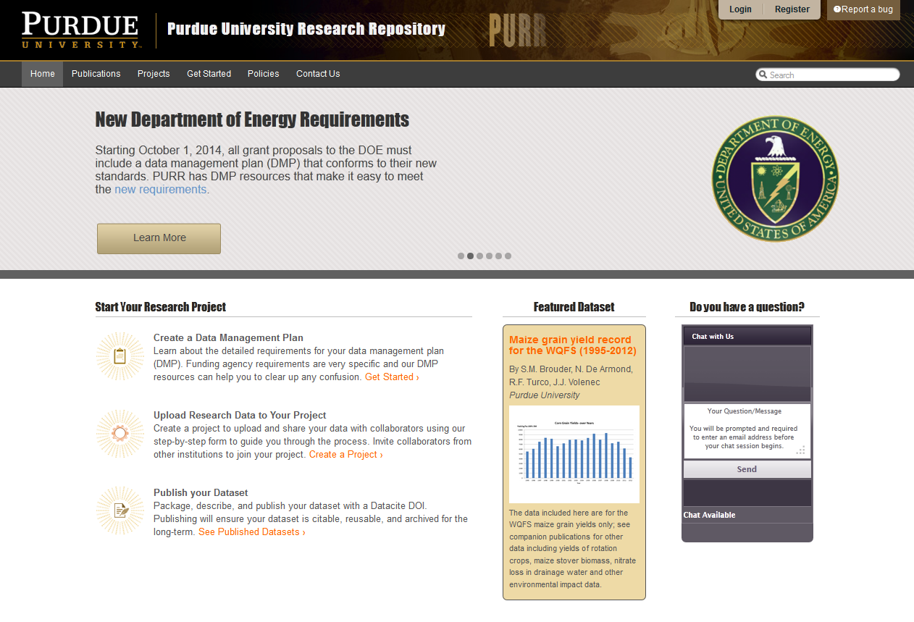
Notes:
Some institutions are developing data repositories to serve their communities: in much the same way institutional repositories host publications of the institution’s faculty, researchers, and students, institutional data repositories like the Purdue University Research Repository (PURR) host research data.
https://purr.purdue.edu/

Slide 13
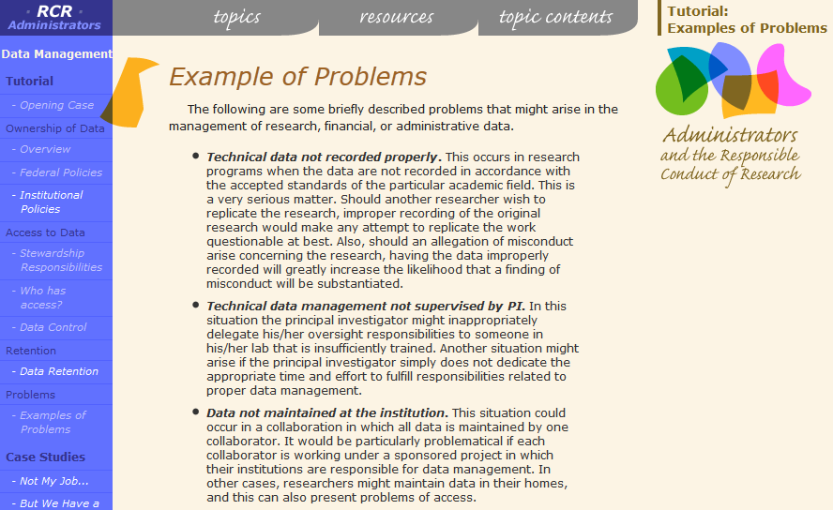
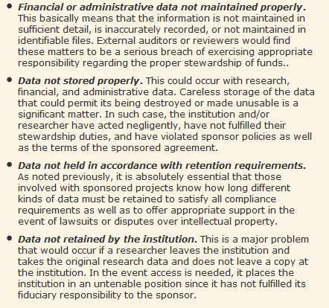
Data Management Issues
Notes:
These are several data management issues identified by the U.S. Office of Research Integrity that we will cover today. For each issue we will provide you with examples of best practices and contacts for obtaining assistance.
1. Lack of responsibility
2. Lack of a data management plan (DMP)
3. Poor records management
4. Lack of metadata and data dictionary
5. Data files are not backed up
6. Lack of security measures
7. Undetermined ownership and retention
8. Lack of long-term plan for the data

Slide 14
Issue #1: Responsibility
Challenges of Team Science and collaborating across institutions
Challenges managing research notes: laboratory notebooks, interview and survey products, etc.
Challenges with rotating research personnel
Notes:
One of the greatest challenges in managing data is the distributed nature of modern research. With so many responsibilities, it is easy to not prioritize data management. By assigning data management tasks, you will increase the efficiency of your research.
Research records such as laboratory notebooks or survey results, paper and electronic, may be audited by the funder, such as NIH. Managing and preserving these records requires a plan.
In many research groups personnel are changing constantly. There must be a plan to bridge the data management knowledge of new and outgoing students, post-docs, and staff.

Slide 15
Notes:
Although funders sponsor PIs and their labs’ research, according to Brandeis policy, the data from federally sponsored research ultimately belongs to the institution.
The PI and students are seen as stewards of data and are responsible for its management and security.
Students should check with their PIs on questions regarding their data management responsibilities, and always confer with them before taking, copying, or sharing any data, with others in the institution but outside of your research group, and especially anyone outside the institution.

Slide 16
Best Practices
Define roles and assign responsibilities for data management
For each task identified in your data management plan, identify the skills needed to perform the task
Match skills needed to available staff and identify gaps
Develop training plans for continuity
Assign responsible parties and monitor results
Notes:
Here are some best practices for outlining roles for managing research records and laboratory notebooks. Unless the distribution of responsibility is clear, misunderstandings can result and compliance jeopardized.
We hear a lot from researchers that they have had to learn data management on the go and may have little to no formal training on how to manage a specific project’s data, so do not be afraid to ask for clarification, and for documenting and formalizing DM roles & responsibilities. This is an important aspect of a data management plan.

Slide 17
Applying Best Practices
There may be policies or laws that affect who should be responsible for different data management tasks within your research team: consult your subject librarian for help determining whether any apply to your research.
Contact your subject librarian for assistance, resources, and tools to better manage the information in your paper and/or electronic laboratory notebooks.
Librarians can also help you to catalog, organize, preserve and archive your laboratory notebooks and/or research notes.
Notes:
Assigning roles and responsibility can be confusing; librarians can help.
Librarians are a great resource for locating tools and resources to help manage laboratory notebooks and organize a data management plan for your lab.
Projects create a large amount of documentation in addition to official notebooks and librarians can help you to catalog, organize and preserve these materials, such as scanning and creating digital back up files.

Slide 18
Issue #2: Data Management Plans (DMPs)
What types of data will be created?
Who will own, have access to, and be responsible for managing these data?
What equipment and methods will be used to capture and process data?
Where will data be stored during and after?
Notes:
Many research funders require that you have a plan to manage and/or share your data. For example, in 2011 the NSF began requiring a data management 2-page supplement with all submitted grant applications. The NIH has requires a plan for projects in excess of $500,000.
Even when the funding does not require a DMP, creating one is a useful process that helps clarify the data management steps and workflow.
These are some questions that are commonly addressed in a data management plan.

Slide 19
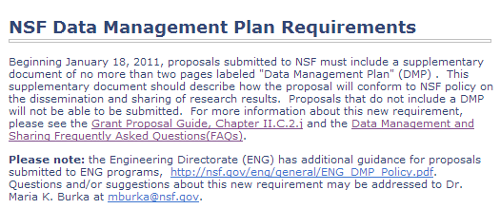
Funder DMP vs the Life Cycle of a Project
Notes:
Brandeis has an institutional account with the DMPTool, and we will shortly be customizing the templates with Brandeis-specific information for storage, security, metadata questions and more. Librarians can go over the tool with you, find example data management plans in your discipline, or help edit/clarify information in your plans.
While a 2-page plan for a grant application is required by some funders, every research project will benefit from planning for managing a project’s data throughout the life of the project, including planning for how data will be produced, collected, analyzed, stored, archived or shared, etc.
Credit: UK Data Archive, http://www.data-archive.ac.uk/create-manage/life-cycle

Slide 20
Issue #3: File Management
Inconsistently labeled files…
in multiple versions
inside poorly structured folders
stored on multiple media
in multiple locations
and in various formats
Notes:
File management is a persistent problem within scholarly workflows - even with our personal devices, most people don’t practice good file management, particularly for consistent naming and version control. The problem is only compounded with lab staff and research assistant turnover.
Good file management requires thinking about how you and others can both easily find and make sense of your data files.

Slide 21
Notes:
This slide comes from a colleague at Northeastern University. She looked at a sample of data files produced by students collecting data a bioscience lab.
As you can see, their file naming conventions do not always take into consideration how someone not involved in a project will make sense of what is in the file.
After some time, these files would probably not even make sense to the person involved in creating the file: what exactly is in awesome 2010, and what changed to make it awesomer!

Slide 22
Best Practices
Avoid special characters in a file name
Use capitals or underscores instead of periods or spaces
Use 25 or fewer characters
Use documented & standardized descriptive information about the project/experiment
Use date format ISO 8601:YYYYMMDD
Include a version number
Notes:
These are some best practices for creating file names. Poorly constructed file names can cause issues when transferring files from one format to another, or to another operating system.
For example, a researcher recently identified that when she moved files from REDCap™ to her analysis software, the dates were reformatted. In addition, OS like Unix can have issues reading files with spaces or special characters. A solution for dates has been developed by ISO.

Slide 23
Applying Best Practices
Librarians can help you with resources and tools for:
Creating file naming conventions
Creating directory structure naming conventions
Versioning your files
Choosing appropriate file formats for preserving and sharing your data files
Notes:
Librarians have a lot of experience with records management, and we invite you to seek our assistance with planning for the organization and labeling of your files, folders and directories.
Many labs have to create systems to track thousands of samples and slides scattered across several freezers, their associated digital files such as images and experimental measures and observations, and then map these with the experiment documentation they are associated with in the paper of e-lab notebook.

Slide 24
Issue #4: Metadata
How will someone make sense of your data, e.g. the cells and values of your spreadsheet?
What best practices or disciplinary standards could be used to label your data?
How can you describe a data set to make it discoverable?
Notes:
File Management is closely related to Metadata. Thanks to Edward Snowden, many Americans are now familiar with the term metadata - it used to be a term only a librarian could love.
We often describe metadata as “data about data,” and largely, that still works. Good metadata are simply descriptors that can help you record information and create labels to catalog and make sense of your data.
Metadata standards can be used to describe the data’s field labels, their values, elements and parameters, and they can also describe the nature of the files that are produced, such as how many bytes, the format, the software used to create the file, the version, and who created it.

Slide 25
Metadata for Data
Notes:
Here is an example of metadata collected about a data set. It states who created the file and when, the format, and descriptive information about the data and its location.

Slide 26
Metadata for Data
Notes:
This second example was created using a standard called DDI, which is being used primarily by social science researchers in Europe, Canada, and Australia (where this example comes from). It’s also being used by ICPSR and some social science research institutes at UofM, so it’s getting some traction here in the US.
This is only a snapshot of the record - there’s a lot more metadata for each dataset than what you see here.

Slide 27
Best Practices
Describe the contents of data files
Define the parameters and the units on the parameter
Explain the formats for dates, time, geographic coordinates, and other parameters
Define any coded values
Describe quality flags or qualifying values
Define missing values
Notes:
Here are some best practices for using metadata to help someone make sense of your data.

Slide 28
Best Practices: Fields
Methodology
Data processing
Sources
List of file names
File Formats
File structure
Variable list
Code lists
Versions
Checksums
Title
Creator
Identifier
Subject
Funders
Rights
Access information
Language
Dates
Location
Notes:
Here is a list of common metadata fields associated with a data set.

Slide 29
Applying Best Practices
Librarians can help you with locating metadata standards for creating a data dictionary such at the Clinical Trials Protocol Data Elements Definitions used by the FDA or the important metadata elements identified by the ICPSR.
We can also help you to locate disciplinary and general metadata standards and resources for annotating and describing your data and data files, such as DDI, used in population research, or Dublin Core, which is a general standard that is widely used.
Notes:
Contact us for help with annotating your data and making it searchable and discoverable. We can help you choose a metadata standard to use (Dublin Core, DDI) or come up with original metadata fields.

Slide 30
Issue #5: Backing Up and Securing Data
How often should data be backed up?
How many copies of data should you have?
Where can you store your data?
How much server space can I get?
Notes:
Here are some important aspects of data management, made more complicated by the fact that everyone in your research group should be following the same protocol. Make time to discuss your current practices as a research group and to train new team members.

Slide 31
Notes:
Dr. Moore conducted a survey of UCSD researchers and found a wide variety of storage and backup solutions in use. Which is not in and of itself a bad thing – you can see by the percentages that many people are using multiple storage and backup locations, which is really good.
However, I worry about those whose only backup is on that USB drive. Held by a grad student. Who just went home for Thanksgiving when the article has to be submitted December 5th.
For enquiries on storing and securing human subject’s data, be sure to work with the IRB office and the LTS Security group to ensure proper policies are being followed regarding anonymization and encryption.
Brandeis IRB: http://www.brandeis.edu/ora/compliance/irb/index.html
Brandeis IT Security: http://lts.brandeis.edu/techhelp/security/index.html

Slide 32
Best Practices
Make 3 copies (original + external/local + external/remote)
Have them geographically distributed (local vs. remote)
Use a Hard drive (e.g. Vista backup, Mac Timeline, UNIX rsync) or Tape backup system
Cloud Storage - some examples of private sector storage resources include: (Amazon S3, Elephant Drive, Jungle Disk, Mozy, Carbonite)
Unencrypted is ideal for storing your data because it will make it most easily read by you and others in the future…but if you do need to encrypt your data because of human subjects then:
Keep passwords and keys on paper (2 copies), and in a PGP (pretty good privacy) encrypted digital file
Uncompressed is also ideal for storage, but if you need to do so to conserve space, limit compression to your 3rd backup copy
Notes:
Here are some best practices for backing up and securing your data. Electronic data should be saved on a device that has the appropriate security safeguards such as unique identification of authorized users, password protection, encryption, automated operating system patch (bug fix), anti-virus controls, firewall configuration, and scheduled and automatic backups to protect against data loss or theft.
For data stored in hard-copy, such as paper lab notebooks, making a digital scan is a valuable backup practice. LTS can consult with you on methods and best practices but does not offer digitization services at this time. Contact your subject liaison for more information.

Slide 33
Applying Best Practices
Consult Research Technology: researchtechnology@brandeis.edu
On-campus Research Omega storage provisioning – up to multi-TB
Personal server hardware and set-up advice
Cloud storage and backup solutions
Other backup advice: e.g., external hard drive recommendations
Consult Information Security: security@brandeis.edu
IRB & other compliance implementation
Setting encryption and permissions
Notes:
At Brandeis, LTS has experts able to support your storage and backup needs, and more experts for addressing security issues. Some of you will have met Ian Roy and his capable student workers, or Dave DiGennaro in Information Security who also sits on the IRB review board. They are happy to help at any stage in the research process, though my advice is that the earlier the better. It is easier to set up good backup solution before you also need to copy TB of data to each location. It’s certainly cheaper to ask for a hardware or software recommendation than to buy something and only ask when that fails to meet you needs.

Slide 34
Issue #6: Ownership and Retention
Intellectual Property Policy
IRB data retention policy
Funders’ data retention policy
Publishers’ data retention policy
Federal and State laws
Notes:
When it comes to data ownership and data retention there are a lot of overlapping policies. IP policy can cover the ownership and retention of data related to patents, the IRB wants to ensure that documentation of human subjects’ data are retained and/or destroyed appropriately, the funders and publishers want you to retain data to defend the integrity of your findings, and then there are federal guidelines such as those pertaining to HIPAA or those pertaining to Veterans’ Affairs research.

Slide 35
Notes:
Going back to one of our very first reasons to practice good data management, here is an example of a paper that had some of it’s data challenged years later.
The publisher contacted the researchers to have them update the data, but they could not locate the original data files after six years, so the journal was forced to issue a retraction.

Slide 36
Notes:
The journal stood by the parts of the paper the PI could provide data for, but decided to retract a figure for which the data could not be found.
This case highlights how difficult it is to know for how long to keep data. This article was peer reviewed and cited over 55 times but it took six years for the representation of its data to be called into question. Thus, thinking about ways to digitize documents and store and preserve electronic files of data in a self-archived, disciplinary, or local data repository is important, and one of the many tasks the library can help you with.

Slide 37
Retention Best Practices: It Depends
IRB OHRP Requirements: 45 CFR 46 = 3 years from completion
HIPAA Requirements: = minimum of 6 years from date of signed authorization
FDA Requirements 21 CFR 312.62.c = 2 years following the date a marketing application is approved for the drug or the investigation is discontinued and FDA is notified.
VA Requirements: At present records for any research that involves the VA must be retained indefinitely per VA federal regulatory requirements.
Intellectual Property Requirements - Any research data used to support a patent through must be retained for the life of the patent in accordance with Intellectual Property Policy.
Questions of data validity: If there are questions or allegations about the validity of the data or appropriate conduct of the research, you must retain all of the original research data until such questions or allegations have been completely resolved.
Notes:
As you can see, data retention is very situation dependent. A sponsor may require you to retain your research related documents. Prior to agreeing to a contract that specifies how long records will be maintained, you should ensure that you will receive adequate funding to pay for their storage and preservation. The library can help provide guidance on long-term preservation.
Again, it would be prudent to check with the sponsor, IRB, and Office of Research before destroying any records…

Slide 38
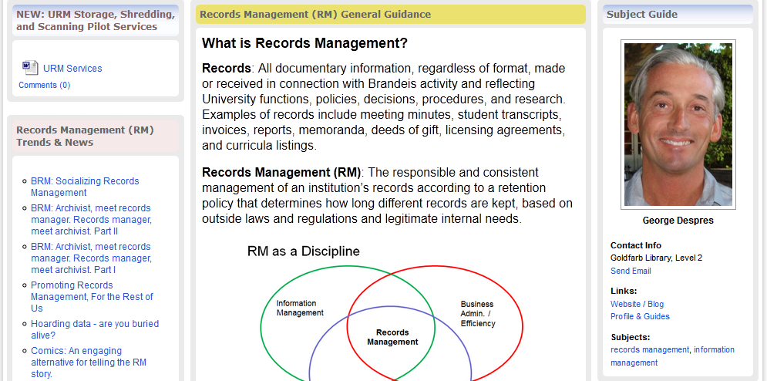
Applying Best Practices
Check your funder or publisher requirements
If these are unclear, contradictory, or absent, consult the University Records Manager, George Despres: records@brandeis.edu
Or consult our Records Management Guide: http://brandeis.libguides.com/URM
Notes:
LTS has a specialist in records retention: George Despres, the University Records Manager. He has created an online research guide for records management that provides useful information in making these decisions. He is also available to consult on records management for a research project, past, present or future.

Slide 39
Issue#7: Long-Term Planning
What will happen to my data after my project ends?
How can I appraise the value of my data?
What are my options for archiving and preserving my data?
What are my options for publishing and sharing data?
Notes:
After a project you may want to consider appraising, and publishing or depositing your data in a repository. There are a variety of factors that impact your ability to share data with outside parties. According to the OHRP, you should contact the IRB prior to proceeding with a release of human subject data unless (a) your subjects signed an IRB approved consent document with HIPAA compliant authorization language that clearly details what information will be collected, used, and disclosed and (b) the outside party is specified in the document.
Even if your permissions are in order, there may be other barriers to effectively sharing your data. File format is an issue that often doesn’t come up until it is an issue but software changes, some types of software are in vogue for a few years and then a new program emerges, requiring a change in file format. Hardware changes, such that if your backups or least compressed version of your data is on a zip disk, you would currently need to go to some effort to get at it. These issues have a great affect on the long-term preservation of data files.

Slide 40
Importance of Formats
Notes:
One of the greatest challenges for preservation is thinking ahead about the formats of your data.
This graphic was created by a colleague that observed the number of instruments in just one biomedical lab at Northeastern relying on proprietary software.
This means that to be able to open and view this file, someone would need to know the software that created it, and be able to access that software. Overall, converting your files to open source and sustainable formats and standards are essential for long-term sharing, preservation and access.

Slide 41
Best Practices
Is the file format open (i.e. open source) or closed (i.e. proprietary)?
Is a particular software package required to read and work with the data file? If so, the software package, version, and operating system platform should be cited in the metadata…
Do multiple files comprise the data file structure? If so, that should be specified in the metadata…
When choosing a file format, select a consistent format that can be read well into the future and is independent of changes in applications.
Non-proprietary: Open, documented standard, Unencrypted, Uncompressed, ASCII formatted files will be readable into the future.
Notes:
Here are some considerations for making your files available for the long-term. In particular, we recommend stable, proven file types, such CSV and ASCII, that are also open, non-proprietary.

Slide 42
Applying Best Practices
Librarians can help you to appraise your data and plan for the long-term preservation of your research data. This includes:
Creating a doi and persistent id for maximizing discoverability of your data and measuring its citation impact
Locating file formats suitable for long-term preservation
Locating and submitting data to a suitable data repository
Choosing metadata standards for increased discoverability
Help with publishing and sharing your data
Notes:
Gina: Once you’re ready for long term preservation, you need to identify a place for it. Most of you will use discipline-specific repositories, although some of you may be unsure what to do with your final dataset. If you opt for a subject-specific repository, we can help you prepare your data for it.
For instance, in the library we commonly get questions about dois. A doi is a unique alphanumeric string assigned to any digital object, any object! – it can be a data set, an electronic journal article, an e-book chapter, a chart, model, etc. We create a set of basic metadata and a create a URL pointer to the full text of your article and its matching data set, so that it uniquely identifies the content item and provides a persistent link to its location on the internet. This allows you to not only measure the citation impact of your publications but also the citation impact of your data!

Slide 43
For More Information:
For storage and backup solutions please send a request to Ian Roy’s research technology support team at researchtechnology@brandeis.edu
For security concerns, particularly for HIPAA and other personal data please consult Mike Corn’s campus security group at security@brandeis.edu
For retention requirements and file destruction best practices, please consult the University Records Manager, George Despres: records@brandeis.edu
For help drawing up a DMP, setting up file management workflows, identifying more stable file formats, more complete metadata descriptions, appropriate data repositories and more, please contact your subject librarian.

Slide 44
Works Cited
DataONE. 2013. “Best Practices for Data Management.”
http://www.dataone.org/best-practices.
MIT Libraries. 2013. “Data Management and Publishing.” MIT
http://libraries.mit.edu/guides/subjects/data-management/index.html.
Office of Research Integrity. 2013. “Data Management.” United States Department of Health and Human Services. United States Federal Government.
http://ori.hhs.gov/education/products/rcradmin/topics/data/open.shtml.
Special thanks to Jen Ferguson, Richard Moore and Glenn Gaudette for permission to use their slides.

