Slide 1
How Not to Lose Track of Your Research
Organization and Planning Resources at Brandeis
Melanie Radik and Raphael Fennimore
Library & Technology Services Workshops
Brandeis University
October 6, 2015
Notes:
Welcome to this section of the LTS Research Data Management workshop series!
Melanie Radik, Science Librarian
Raphael Fennimore, Desktop Systems Analyst
Our goal today is to introduce you to some tools and services available to you at Brandeis, and some strategies you can use to make sure you’re not one of the half dozen or so researchers every year who lose some or all of their research to user error.

Slide 2
Best Practice: Planning
Have a plan for each stage of your your research, from start to finish
many grant applications now require a Data Management Plan
Brandeis IRB applications require a ‘Plan for data storage’
Brandeis has an Institutional account with the Data Management Plan Tool, DMPTool
Notes:
Having a plan for managing your data from start to finish can help you keep track of all of the moving parts. Research records such as laboratory notebooks or survey results, paper and electronic, may be audited by the funder, such as NIH. Managing and preserving these records requires a plan. And in fact data management plans are frequently required in a grant application, and always for a Brandeis IRB approval application.
Brandeis IRB application require the inclusion of a ‘Plan for data storage,’ part q of the written Protocol. Instructions for this section:
describe what you will do with the data you collect (including consent documents, surveys, notes, etc.)
where it will be stored, how long it will be kept
when and how it will be destroyed.
Investigators should be familiar with the Brandeis Information Security Plan and should plan their data storage accordingly.
Brandeis provides institutional access to an online tool for creating data management plans called the DMPTool. It leads you through the sections of a data management plan with prompts and reminders of the sort of information the reviewer will be looking for. The DMPTool also provides templates for the most common funders’ plan requirements, such as the NSF, NIH, DOJ, and Sloan Foundation. It also provides examples of completed data management plans for many funders. If you need assistance connecting to the DMPTool, please contact the Tech Help Desk. If you would like to consult about writing a data management plan for your research, please contact your subject liaison librarian.

Slide 3
Example Questions for DMP
What types of data will be created?
Who will own, have access to, and be responsible for managing these data?
What equipment and methods will be used to capture and process data?
Where will data be stored during and after?
Notes:
Images, video, mapping/GIS data, numerical measurements, survey results, interviews - all count as research data.
Raw Data: What is being measured or observed? The data being generated during the research project.
Processed Data: Making the raw data useful/manipulable
Analyzed Data: Manipulated/interpreted data. What does the data tell us? Is it significant? How so?
Finalized/Published Data: How do the data support your research question?
Existing Data across Different Sources: e.g. GIS data
Who can view the data? Who can edit the data? If a person in the group leaves, who takes over their responsibilities?
What are the make and models of your equipment? What version software are they using? What is your experimental method? What types of analyses will you run on your collected data? Using what software or code?
Does your research group store data in a shared network drive? Is it input into a database? Is each person responsible for their own data? How does the PI get a hold of it when a researcher leaves? If there is personally identifiable information or other sensitive data being handled, are your storage methods compliant with the required security? Once the research is complete, is there a process for safely disposing of sensitive information or preserving valuable data for the long term?

Slide 4
Responsibility
Define roles and assign responsibilities for data management
For each task identified in your data management plan, identify the skills needed to perform the task
Match skills needed to available staff and identify gaps
Develop training plans for continuity
Assign responsible parties and monitor results
Notes:
One of the greatest challenges in managing data is the distributed nature of modern research. With so many responsibilities, it is easy to not prioritize data management. By assigning data management tasks, you will increase the efficiency of your research.
Laboratory notebooks, paper and electronic, may be audited by the funder, such as NIH. Managing and preserving these notebooks require a plan.
In many labs personnel are changing constantly. There must be a plan to bridge the data management knowledge of new and outgoing students, post-docs, and staff.
Here are some best practices for outlining roles for managing data and laboratory notebooks. Unless the distribution of responsibility is clear, misunderstandings can result and compliance jeopardized.
Although funders provide funds to sponsor PIs and their labs’ research, according to Brandeis policy, the data from federally sponsored research ultimately belongs to the institution.
The PI and researchers are seen as stewards of data and are responsible for its management and security.
Students should check with their PIs about question regarding their data management responsibilities, and always confer with them before taking, copying, or sharing any data, within the institution or outside your lab.
We hear a lot from students that they have had to learn data management on the go and may have little to no formal training on how to manage a specific project’s data, so please put some thought into documenting and formalizing data management roles & responsibilities. This is an important aspect of a data management plan.

Slide 5
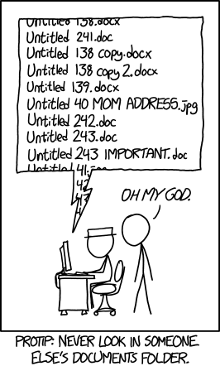
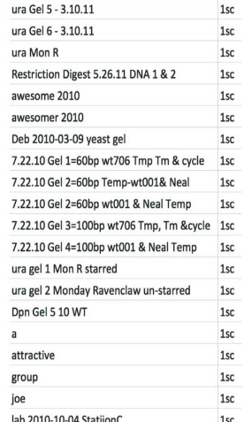
XKCD created by Randall Munroe
image credit: Jen Ferguson
Notes:
Issues of File Organization
While the image on the left is a cartoon, the one on the right comes from an actual researcher’s computer. Issues include long titles that still manage to be uninformative, use of symbols that won’t be accepted on every system, lack of a file identifying itself as an abbreviation key or file naming system outline.
attractive?
awesome and awesomer?
ura Gel 5 - 3.10.11 vs. ura Gel 6 - 3.10.11?
ura gel 2 Monday Ravenclaw un-starred?

Slide 6
File Naming System
Have a system for naming files and folders
check with your research group for an existing system
explore standards for your discipline
are there common abbreviations?
follow general technical standards
dates should be written year month day numerically, yyyymmdd
give files meaningful, descriptive names
avoid special characters and spaces
keep them short, <25 characters total
Notes:
Anyone who has deleted a folder they thought was empty only to find out it had the only copy of that spreadsheet in it, Saved a document instead of Saved As, or just lost track of where certain data was and had to open every single file on their computer to find it knows the pain of losing data to disorganization. Good file management also requires thinking about how you and others can both easily find and make sense of your files.
The important part of folder organization is that it makes your life easier. Do you think about your research chronologically? Give each month a folder! Organize by experiment name, project type, or collaborators’ names. Whatever works for you. Just be consistent, both individually, and across a research group - especially in shared folders. Ideally, research groups will have a codified file naming system that new researchers are trained on.

Slide 7
credit:Gaudette 2013
Notes:
Here is an example from a biomedical engineering lab that shows how you can add in project information into the file name. Notice that the researcher labels each file with an experiment that links back to the laboratory notebook. This allows multiple people and multiple experiments involving the same sample, without confusing who is using it in where. Having a systematic approach to labeling and mapping files allows for the efficient retrieval and interpretation of the data.

Slide 8
Versioning
Practice versioning
instead of Save after substantial changes, Save As
include version number in file name
don’t rely solely on built-in software versioning
use a sequential numbered system: v001, v002
if shared document, be aware of others’ edits
agree in advance on version control measures
who should have ultimate responsibility for final version
version control software exists, automatic versioning
Mercurial
TortoiseSVN
Notes:
Consider strategies you might use for version control; how will you keep track of which file is the most current? Version control can be particularly challenging for collaborative projects in which several people may be able to change a file.
Why would you want to keep older versions of your paper, when the newer version has the latest work? Maybe an earlier section of your paper was taken out that you later need to include. Maybe there’s a miscommunication between yourself and a collaborator and you need to revert to an earlier layout. If you’ve put time and effort into it, don’t just throw it away. Even if it doesn’t make it into the final version, having it on hand for future efforts might come in handy.
Manual file name versioning:
Don't use confusing labels, such as 'revision', 'final', 'final2', etc.
When using sequential numbering, make sure to use leading zeros to allow for multi-digit versions. For example, a sequence of 1-10 should be numbered 01-10; a sequence of 1-100 should be numbered 001-010-100.
Version control software (SVN) such as Mercurial, or TortoiseSVN, can track revisions to files and help you roll back to a previous version of a file. Brandeis LTS maintains a versioning server called svn.unet.brandeis.edu using the apache svn Subversion to backup UNet Home Spaces and files.brandeis.edu. We do not officially support any versioning software for individual use and cannot guarantee troubleshooting or installation assistance.
Google Drive, Adobe, newer Word programs and similar software have some built-in versioning. They both compress or discard older versions after a certain point and are not true version control.

Slide 9
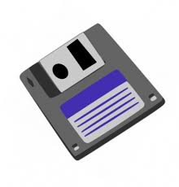
File Types
Protect file integrity
use archival formats
migrate data to avoid obsolescence
practice careful file type reformatting
Data formats that offer the best chance for long-term access are both
Nonproprietary (also known as open)
Unencrypted and uncompressed
Notes:
Files can become useless if the software that can open them is no longer available. This is a common problem for lab equipment and analysis software that saves files in proprietary formats. We have recommendations for saving your files in what are called archival formats. These formats are open/non-proprietary, and are the best option for having files that are still accessible long after your thesis is complete.
Non-proprietary or Open Formats are Readable by more than just the equipment and/or program that generated it. Sometimes proprietary file formats are unavoidable. However, proprietary formats can often be converted to open formats.
Unencrypted / uncompressed Formats: offer the best prospects for long-term access. If files are encrypted and/or compressed, the method used will need to be both discoverable and usable for file access in the future.

Slide 10
File Formats
Examples of preferred formats for various data types:
Moving Images: MOV, MPEG
Audio: WAVE, MP3
Numbers/statistics: ASCII, SAS
Images: TIFF, JPEG 2000
Text: PDF/A, ASCII
For these and more, see:
Stanford Libraries File Formats for Long-Term Preservation
Sustainability of Digital Formats, Library of Congress
Notes:
Archival formats pay attention to the issue of data loss through compression, where a large format file is saved in a different format that takes up less space: it takes up less space because it saves less information. A common example is .tiff image files saved as .jpg.
Carefully note the steps taken during the conversion/migration
A best practice, whenever possible, is to keep the original file as well as the converted one

Slide 11
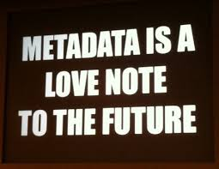
Metadata
Context matters
save everything you’d need to use the file in the future
software to open it
abbreviation keys
experimental protocols
equipment used/analysis programs
units of measurement
record information about how you collected your data with the data in a way that won’t be lost or confused
Who, What, Where, When, and Why of your data
Notes:
Files can also lose their long-term value if they don’t contain enough information about themselves. You might open a spreadsheet that has a good file name, so you know it contains data from a certain experiment on a certain date, but discover that the data inside it is useless to you because no one recorded what the units are. This information is called metadata, data about data or descriptions of data. It is everything a new researcher would need to know about the data in a file to be able to use it in a paper. Metadata should be saved within the file if possible (e.g. metadata tab of the spreadsheet or granularly labelled rows and columns), or saved as a separate file but in the same folder with a name that clearly indicates which file it should be associated with.
How will someone make sense of your data, e.g. the cells and values of your spreadsheet?
What best practices or disciplinary standards could be used to label your data?
How can you describe a data set to make it discoverable?
For instance:
Who collected this data? Who/what were the subjects under study?
What was collected, and for what purpose? What is the content/structure of the data?
Where was this data collected? What were the experimental conditions?
When was this data collected? Is it part of a series, or ongoing experiment?
Why was this experiment performed?
Archival file formats abound! As do disciplinary technical standards and even disciplinary metadata schemas. If you’re having trouble identifying which are applicable to your research, please consult your subject liaison librarian.

Slide 12
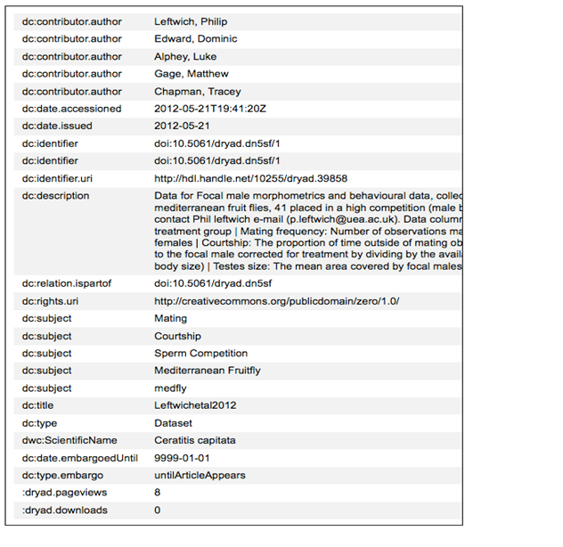
Notes:
Here is an example of metadata collected about a data set. It states who created the file and when, the format, descriptive information about the data, and its location.

Slide 13
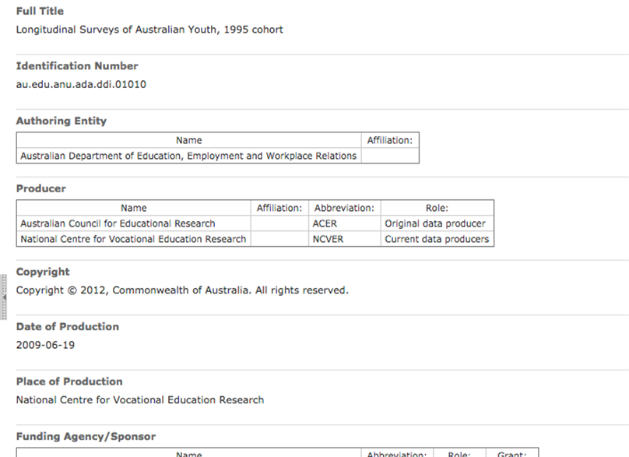
Notes:
This second example was created using a standard called DDI, which is being used primarily by social science researchers in Europe, Canada, and Australia (where this example comes from). It’s also being used by ICPSR and some soc sci research institutes at UofM, so it’s getting some traction here in the US.
This is only a snapshot of the record - there’s a lot more metadata for each dataset than what you see here

Slide 14
Example Metadata Tasks
Describe the contents of data files
Define the parameters and the units on the parameter
Explain the formats for dates, time, geographic coordinates, and other parameters
Define any coded values
Describe quality flags or qualifying values
Define missing values
Notes:
How will someone make sense of your data, e.g. the cells and values of your spreadsheet?
What best practices or disciplinary standards could be used to label your data?
How can you describe a data set to make it discoverable?

Slide 15
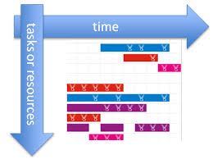
Time Management & Productivity Tools
Project management and timeline software
Google Tasks list
Excel timeline templates
Excel Gantt chart
Microsoft Project
Citation management software
EndNote
zotero
Notes:
Depending on the scope of your research, you may want to look into programs that help you organize your workflow. Citation management tools such as EndNote or Zotero are invaluable when juggling the hundreds of citations necessary for a thesis or dissertation. Google Calendar can help manage appointments, classes, and also has a Tasks list function. Microsoft Excel offers several timeline or project management templates that can assist in organizing a project. For the full project management software need, Brandeis gets a discount on Microsoft Project through the licensed reseller SHI. Other software is available to you as a Brandeis community member for free or at greatly reduced cost.

